Slide 1
Texture Generation
Ryan Richardson
CS629-02
Spring 2020

Slide 2
Functionality
Current
Future Expansion
Procedural Generation of (Un)Structured, Cellular, and Self-Organising Textures using Simplex Noise, Perlin Noise, Worley and Anisotropic Noise, and Reaction-Diffusion
Pared Down Interface for Noise Generation Function Parameters
Basic Texture Application to Images
GGPLOT2 AES Extension
Texture Mapping to Image Subregion
Ability to Overload Noise Generation Functions
3D Mesh Texturing

Slide 3
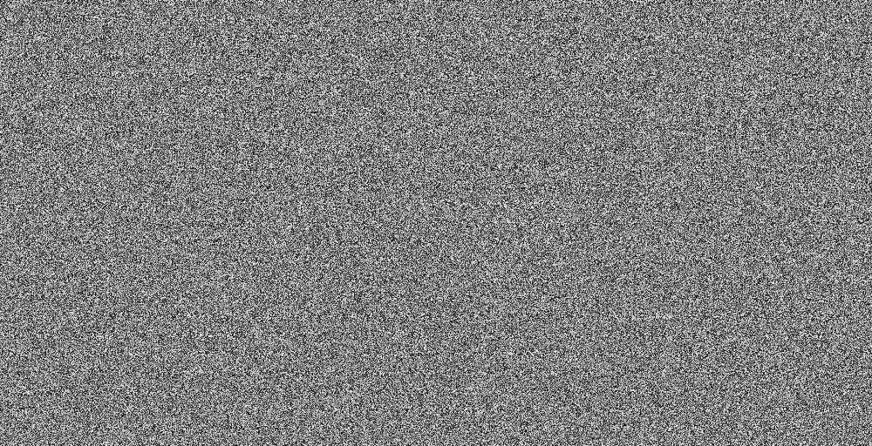
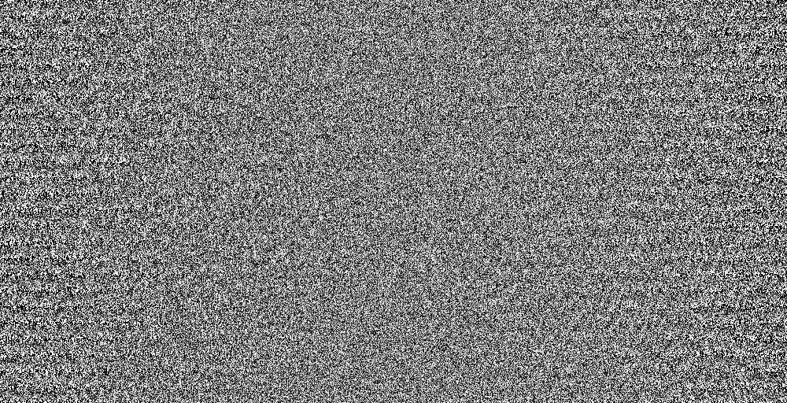
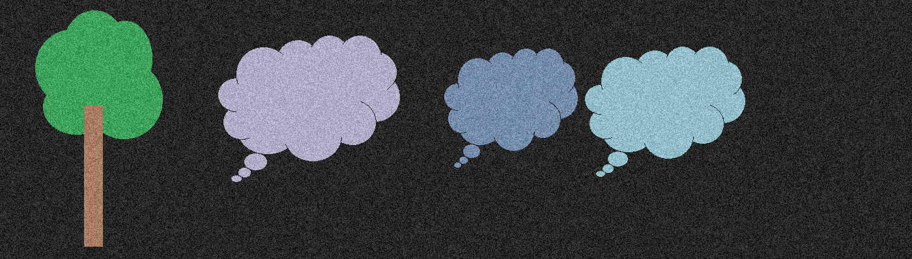

Simplex Noise
Perlin Noise

Slide 4
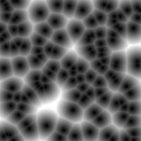
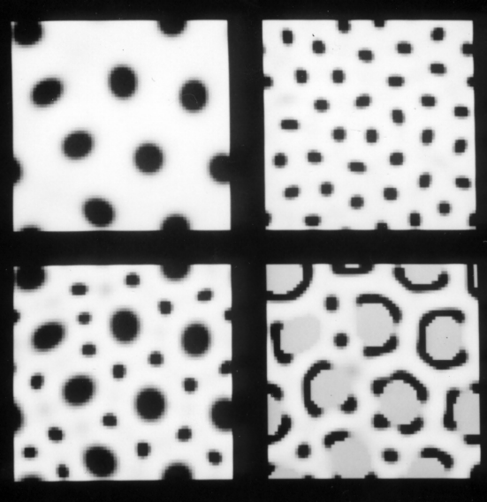
In Development
Worley Noise
Reaction Diffusion

Slide 5
Image References
Worley Noise
Wikipedia User Rocchini
https://en.wikipedia.org/wiki/Worley_noise#/media/File:Worley.jpg
Reaction Diffusion
Greg Turk UNC Chapel Hill
https://www.cc.gatech.edu/~turk/my_papers/reaction_diffusion.pdf

